Slide 1
Chapter 3 Objectives
The CCNA Topics Covered in this chapter include:
  Modes of switch
  Basic configuration of a switch
  Verifying switch configuration
  Port security

Slide 2
Switch Command Modes
Switches have several command modes.
The default mode is User EXEC mode, which ends in a greater-than character (>).
The commands available in User EXEC mode are limited to those that change terminal settings, perform basic tests, and display system information.
The enable command is used to change from User EXEC mode to Privileged EXEC mode, which ends in a pound-sign character (#).
The configure command allows other command modes to be accessed.

Slide 3
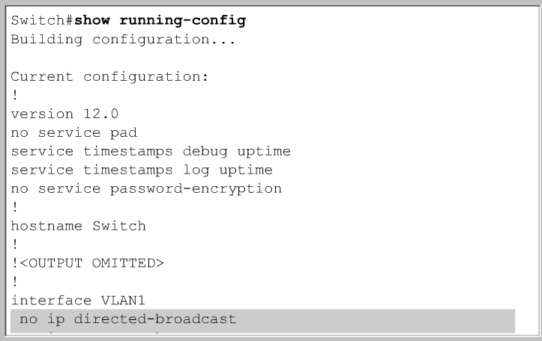
show running-config

Slide 4
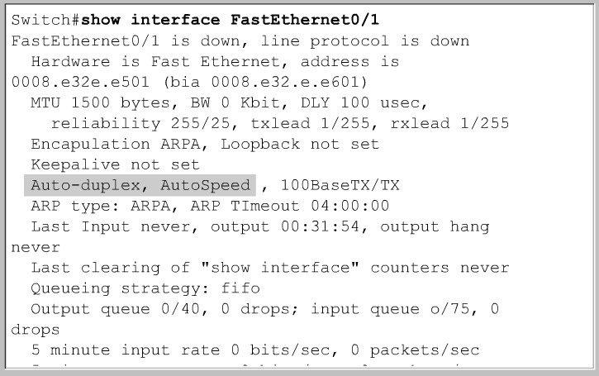
show interface

Slide 5
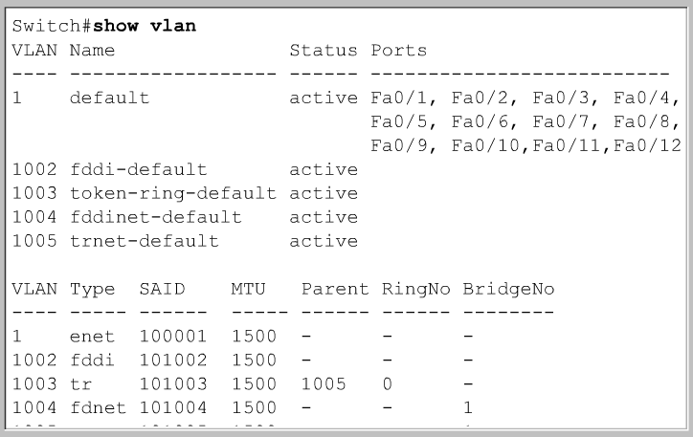
show vlan

Slide 6
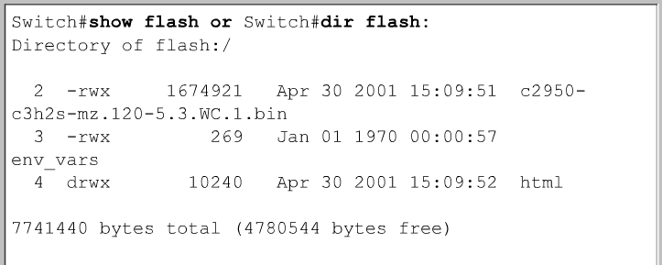
show flash

Slide 7
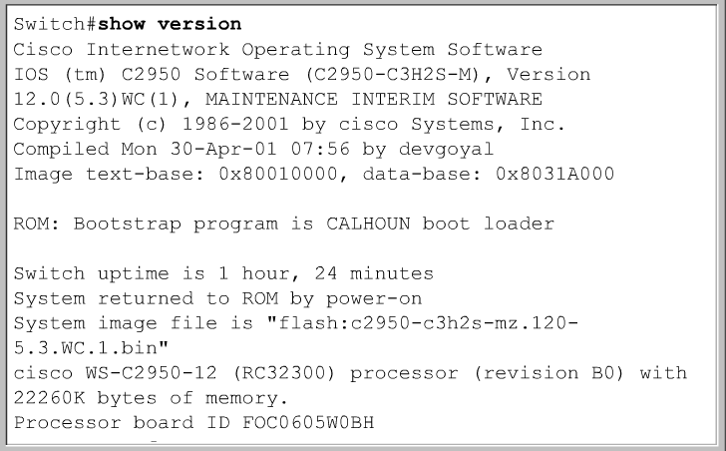
show version

Slide 8
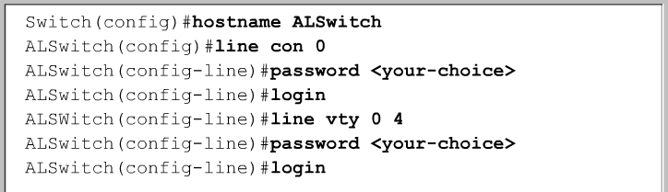
Setting Switch Hostname
Setting Passwords on Lines

Slide 9
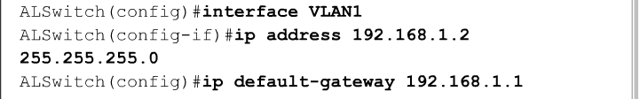
Set IP Address and Default Gateway
To allow the switch to be accessible by Telnet and other TCP/IP applications, IP addresses and a default gateway should be set.
By default, VLAN 1 is the management VLAN. (more later)
In a switch-based network, all internetworking devices should be in the management VLAN.
This will allow a single management workstation to access, configure, and manage all the internetworking devices.

Slide 10
Set Port Speed and Duplex Settings
The Fast Ethernet switch ports default to:
  auto-speed
  auto-duplex.
This allows the interfaces to negotiate these settings.
When a network administrator needs to ensure an interface has particular speed and duplex values, the values can be set manually.

Slide 11
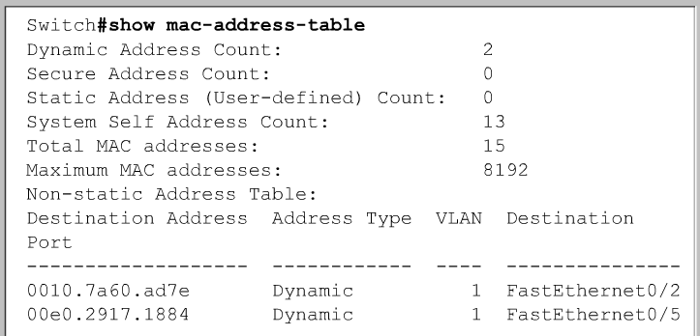
Managing the MAC address table
Switches learn the MAC addresses of PCs or workstations that are connected to their switch ports by examining the source address of frames that are received on that port.
Machines may have been removed from a port, turned off, or moved to another port on the same switch or a different switch.
This could cause confusion in frame forwarding.
The MAC address entry is automatically discarded or aged out after 300 seconds.

Slide 12
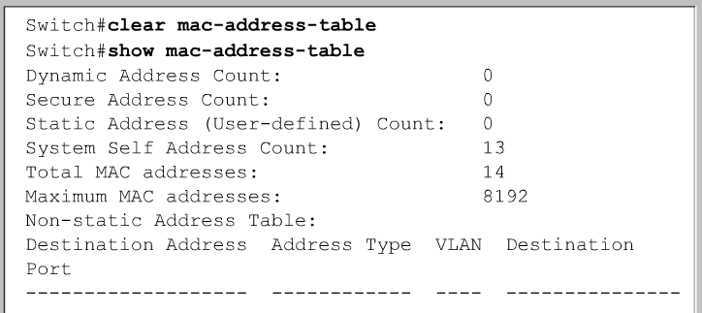
Managing the MAC address table
Rather than wait for a dynamic entry to age out, the administrator has the option to use the privileged EXEC command clear mac-address-table.

Slide 13
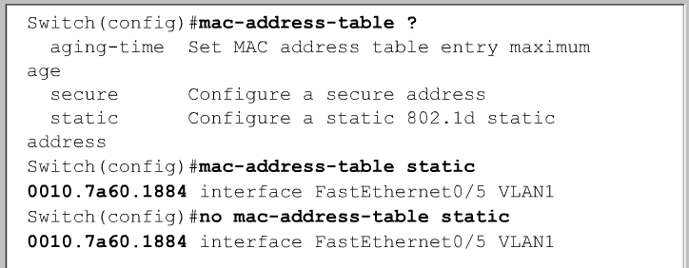
Configuring static MAC addresses
The reasons for assigning a permanent MAC address to an interface include:
  The MAC address will not be aged out automatically by the switch.
  A specific server or user workstation must be attached to the port and the MAC address is known.
  Security is enhanced.
To set a static MAC address entry for a switch:
Switch(config)#mac-address-table static <mac-address of host> interface FastEthernet <Ethernet numer> vlan

Slide 14
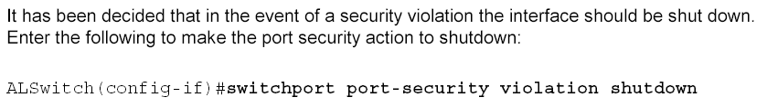
Switch Security Commands
Switch(config-if)#switchport mode access
Set the interface mode as access; an interface in the default mode (dynamic desirable) cannot be configured as a secure port.
Switch(config-if)# switchport port-security
Enable port security on the interface
Switch(config-if)# switchport port-security maximum value
(Optional) Set the maximum number of secure MAC addresses for the interface. The range is 1 to 132; the default is 1.
Switch(config-if)# switchport port-security mac-address mac-address

